Slide 1
Project Recovery (MGMT-6060)
Project Topic: Ottawa-Windsor Express Rail
Team Members (Team 09)
M M Navid Al Adnan (1169345)
Rona R. Bautista (0897048)
Hitenkumar B. Patel (1120292)
Ronisha Pokharel (1187263)
Gihan Shamike Liyanage (1142109)
Disclaimer: This project is created for academic purposes only. It is not sponsored by or reviewed by any real organizations discussed in this report.

Slide 2
Preliminary Stakeholder Register
The Government of Canada has established the High-Frequency Rail (HFR) in 2016.
Transport Canada – Project Authority leading the project (on behalf of the Minister of Transport).
Members (supported by the Department of Justice)
Infrastructure Canada
Public Services
Procurement Canada
VIA HFR (VIA Rail Subsidiary to support High Frequency Rail)
Additional stakeholders are
Landowners | Labor Unions | Indigenous Communities
Local Communities | Utility Companies | Businesses and Industries
Environmental Groups | Tourism Organizations | Passenger Advocacy Groups
Emergency Services | Rail Operators
Reference:
Borealis. n.d. The Challenge. Building on Lessons Learned.
https://www.boreal-is.com/use-case-rail-industry/

Slide 3
Preliminary Stakeholder Register
Stakeholder engagement can help the organization achieve better outcomes, whether it is education, connection, engagement or profit.
Empower people – Get stakeholders involved in the decision-making process.
Create sustainable change – Engaged stakeholders help inform decisions and provide the support that the organization needs for long-term sustainability.
Build relationships – Create mutually beneficial relationships, build on existing relationships or foster new ones.
Build a better organization – Engaging with stakeholders can bring important issues to light and encourage the organization to develop corporate social responsibility.
Increase success – Engaging influential groups and turning them into supporters and advocates can boost the organization’s chances of success.
Educate – Stakeholders can be a valuable source of information for the organization, and they may learn something from it.
Reference:
Hendricks, A. n.d. Simply Stakeholders. The Importance of Stakeholders: Identifying and Prioritizing Stakeholder Engagement.
https://simplystakeholders.com/the-importance-of-stakeholders/

Slide 4
Preliminary Stakeholder Register
As the Ottawa-Windsor Express Rail project progresses, effective stakeholder engagement is paramount for success. We have identified various stakeholder needs and devised solutions to address them, ensuring transparent communication and collaboration throughout the project lifecycle.
Stakeholder Needs and Solutions:
Central Registry Establishment: Develop a comprehensive database to track stakeholder involvement.
Unified Stakeholder Information: Integrate data into a single platform for streamlined communication.
Mapping Stakeholder Influence and Concerns: Use mapping tools to understand affiliations and tailor engagement strategies.
Real-Time Reporting for Management: Provide timely updates to management for informed decision-making.
Reference:
Borealis. n.d. Stakeholder Engagement Platform. How To Engage Stakeholders And Strengthen Your Strategy
https://www.boreal-is.com/modules/stakeholder-engagement

Slide 5
Preliminary Stakeholder Register
Stakeholder | What They Will Receive from the Project | What the Project Will Receive from Them
Government | Improved transportation infrastructure | Funding, regulatory approvals, support
Local Communities | Enhanced connectivity, potential economic opportunities | Input, support, feedback on local impacts
Environmental Groups | Mitigation of environmental impacts, sustainable practices | Expertise, guidance on environmental stewardship
Emergency Services | Enhanced emergency response capabilities | Collaboration, support for emergency planning
Labor Unions | Job opportunities, fair labor practices | Labor support, collaboration
Utility Companies | Infrastructure coordination, minimal disruptions | Collaboration, support for utility relocation
Tourism Organizations | Increased traffic, economic growth | Promotion, tourism collaboration
Reference:
Borealis. n.d. Stakeholder Engagement Platform. How To Engage Stakeholders And Strengthen Your Strategy
https://www.boreal-is.com/modules/stakeholder-engagement

Slide 6
Required Resources - People Involve
Stakeholders | These are the group of people that overall approved the whole project, from the requirement, design, initiation and closing of the project.
PMO and Team | Professionals who organize, plan, and execute projects while working within restraints like budgets and schedules. Project managers lead entire teams, define project goals, communicate with stakeholders, and see a project through to its closure.
HSE Team | Collaborate with law enforcement agencies to ensure security measures are in place.
R&D Team | Develop detailed engineering plans for every aspect of the project, including track alignment, station layouts, bridges, tunnels, signaling systems, and power supply.
Procurement | Creating bidding documents for suppliers and contractors.
Reference:
Staff, C. November 29, 2023. Cousera. What Is A Project Manager? A Career Guide.
https://www.coursera.org/articles/what-is-project-manager
Jain, S. Aug. 12, 2023. Medium. “Forging the Path: The Construction of Bullet Train Tracks”
https://medium.com/@samarthjain/forging-the-path-the-construction-of-bullet-train-tracks-d2099a0cd11c

Slide 7
Required Resources - People Involve
Logistics and Warehouse Team | Initiate transportation and proper storage of raw and finished products.
TL and Laborers | Ground workers.
IT Team | IT is also used to improve operations, and in a way, it is also linked to scheduling. Optimization can go in several directions: better train control, dispatching, or customer information system.
3rd Party Testing Commissioning Team | Conduct a series of tests to ensure the safety and functionality of the infrastructure, signalling systems, and trains.
Reference:
Staff, C. November 29, 2023. Cousera. What Is A Project Manager? A Career Guide.
https://www.coursera.org/articles/what-is-project-manager#

Slide 8
Required Resources – Physical Equipment
Railway Infrastructure Upgrades: | Track Maintenance Equipment: Track Components: Bridge and Tunnel Renovation: | Track-laying machines, ballast regulators, tamping machines. Rails, ties, ballast, fastening systems. Equipment for strengthening bridges, tunnel repairs.
Rolling Stock & Maintenance Facilities: | Rolling Stock Refurbishment: Depot and Workshop Upgrades: | Refurbishing locomotives, passenger cars. Modifications for enhanced maintenance.
Safety & Control Systems: | Signaling and Control System Updates: Safety Equipment Maintenance: | Higher speed adaptations. Barrier replacement, upgrades.
Communication & Control Systems: | Train Control System Enhancements: Communication Infrastructure: | Modern technology integration. Network upgrades.
Construction & Utility Equipment: | Construction Machinery: Utility Upgrades: | Earthmoving equipment. Relocation equipment, materials.
Station Upgrades: | Station Renovation: Ticketing and Passenger Services: | Accessibility improvements, amenities. Modern installations.
Testing & Measurement Tools: | Track Inspection Equipment: Performance Testing Equipment Gauges and Calibrating Equipment: | Geometry measurement tools. Evaluation instruments Precision measurement tools.
Reference:
Wikipedia. n.d. Railway Track
https://en.wikipedia.org/wiki/Railway_track/

Slide 9
Required Resources – Physical Equipment
Environmental Mitigation Equipment: | Erosion Control Measures: Noise and Vibration Reduction: | Materials for environmental protection. Sound barriers, dampening materials.
Emergency Response Resources: | Emergency Response Equipment: | Firefighting gear, first aid kits.
Additional Resources: | Land Properties: Construction Materials: Heavy Equipment: | Warehouses, offices, temporary on-site facilities. Steel, frames, beams, wooden materials. Mobile cranes, forklifts, trucks, locomotives, hi-rail vehicles, buggies, gondolas.
Reference:
Wikipedia. n.d. Railway Track
https://en.wikipedia.org/wiki/Railway_track/

Slide 10
Required Resources - Time
The old railway construction began in 1881 and took four years to complete in 1885. When was the Canadian Pacific Railway completed? On November 7, 1885, the "Last Spike" was driven at Craigellachie in Eagle Pass, British Columbia, to meet the line to the Pacific coast.
Based on WBS a High-Speed Railway from Windsor to Ottawa may take, 6495 Days to complete this project is 16 to 17 years in the making. From conceptualization, planning, approvals, execution, testing and commissioning and finally turn-over to the client.
Project Initiation | 300 Days
Design and Engineering | 405 Days
Construction and Infrastructure Upgrades | 3990 Days
Technology Adaption | 240 Days
Testing and Commissioning | 300 Days
Monitoring and Evaluation | 210 Days | Total 6495 Days
Reference:
Camilleri, C. Mar. 2, 2023. Canadian Train Vacations. Canadian Pacific Railways Facts
https://canadiantrainvacations.com/blog/canadian-pacific-railway-facts#

Slide 11
Required Resources – Funding
Transport Canada’s Rail Safety Improvement Program (RSIP) provides funding for projects that improve infrastructure or propose research or new technologies to increase safety at grade crossings and along rail lines or that address or prevent the impact of climate change and extreme weather along rail lines. Projects that increase public confidence in Canada’s rail transportation system or education and awareness about rail safety issues are also funded.
Initial Investment: | Capital Investment & Land Acquisition | $6,656,360,000.00
Infrastructure Upgrades: | Track Rehabilitation & Station Renovations, Communication and Control Systems | $18,288,913,000.00
Environmental Mitigation: | Environmental Impact Assessments Green Technologies | $450,000,000.00
Contingency Fund: | Reserve Fund & Cost Overrun Mitigation | $1,500,000,000.00
Total Budget: | Government & Private investments | $25,027,274,306.00
Reference:
Government of Canada. n.d. Rail Safety Improvement Program
https://tc.canada.ca/en/programs/funding-programs/rail-safety-improvement-program

Slide 12
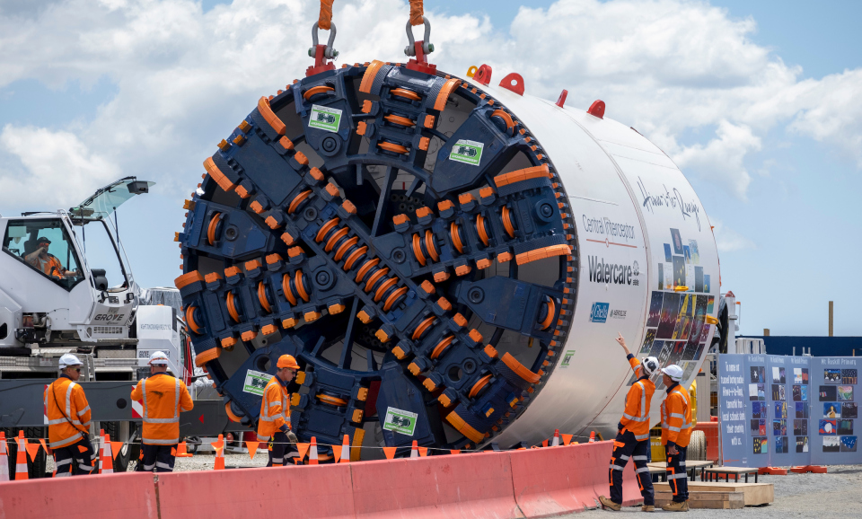
Preliminary Description of Any Technology
Design and Planning:
Detailed possibility studies are carried out to evaluate the project's feasibility before construction, considering variables such as cost, environmental impact, and route selection.
The route is planned by engineers considering variables like topography, population density, and the state of the infrastructure. High-speed trains need straight tracks with mild curves.
Construction Equipment:
Generally, TBMs are utilized for tunnelling. These enormous devices are capable of boring tunnels with little disturbance to the surface through rock and dirt. The tracks are precisely laid and aligned using specialized machinery. The purpose of high-speed rail tracks is to provide efficient, stable, and smooth transport. The need for bridges and viaducts may arise from the topography. These raised constructions are built with specialized machinery.
Preparation of the land involves the employment of excavators, bulldozers, and other earthmoving equipment, particularly in regions where levelling tracks are necessary. For the construction of the tracks, stations, and other structures, high-quality concrete is essential. Large volumes of concrete are produced using batch facilities.
Reference:
Jain, S. Aug. 12, 2023. Medium. “Forging the Path: The Construction of Bullet Train Tracks”
https://medium.com/@samarthjain/forging-the-path-the-construction-of-bullet-train-tracks-d2099a0cd11c

Slide 13
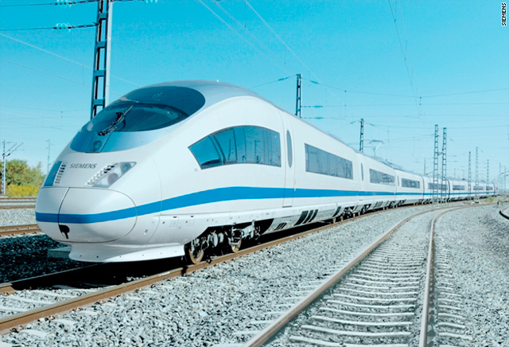
Preliminary Description of Any Technology
Infrastructure and structure:
The speed and volume of passengers are accommodated in the architecture of high-speed rail stations. Platforms, ticketing areas, security, and frequently commercial areas are among them. These are made to guarantee a safe and easy journey. Bridges must endure high-speed loads and environmental conditions, while tunnels can need ventilation mechanisms.
Technology and System:
To ensure both safety and effectiveness, modern train control systems regulate the speed and spacing of trains. Signaling and communication systems fall under this category.
Advanced technology such as regenerative braking systems, tilting mechanisms, and aerodynamic designs are featured in high-speed trains. Power supply systems, which frequently make use of extra rails or overhead wiring, are necessary for electrified high-speed rail lines. The general design incorporates several safety elements, including fire detection, emergency braking systems, and evacuation protocols.
Reference:
Jain, S. Aug. 12, 2023. Medium. “Forging the Path: The Construction of Bullet Train Tracks”
https://medium.com/@samarthjain/forging-the-path-the-construction-of-bullet-train-tracks-d2099a0cd11c

Slide 14
Preliminary Description of Any Technology
Technology and System:
Train Control Systems: Implementation of advanced train control technologies, such as Automatic Train Control (ATC) and Positive Train Control (PTC). These systems enhance safety, efficiency, and capacity on the rail network by providing real-time monitoring and control of train movements.
Communication and Signaling Systems: Deployment of modern communication networks and signaling systems for efficient train dispatching, scheduling, and passenger information dissemination. These systems improve reliability and responsiveness in railway operations.
GPS and GIS Technology: Integrated into construction equipment for precise site mapping, grading, and alignment. Global Positioning System (GPS) and Geographic Information System (GIS) technologies enhance accuracy and efficiency in earthmoving activities.
Telematics Systems: Installed in construction vehicles for real-time monitoring of equipment usage, fuel consumption, and maintenance scheduling. Telematics systems optimize fleet management and productivity on construction sites.
Reference:
Oct. 10, 2023. Federal Railroad Administration. “Positive Train Control (PTC)”
https://railroads.dot.gov/research-development/program-areas/train-control/ptc/positive-train-control-ptc

Slide 15
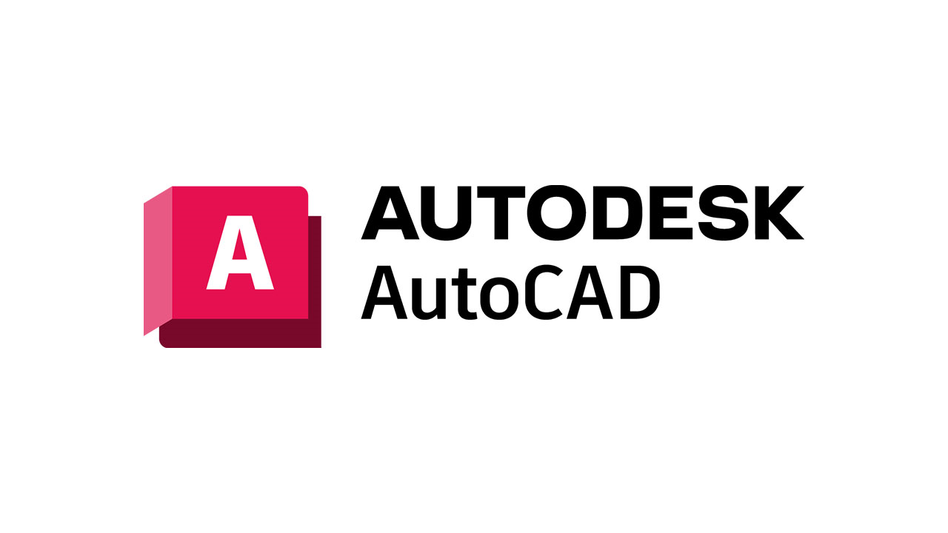
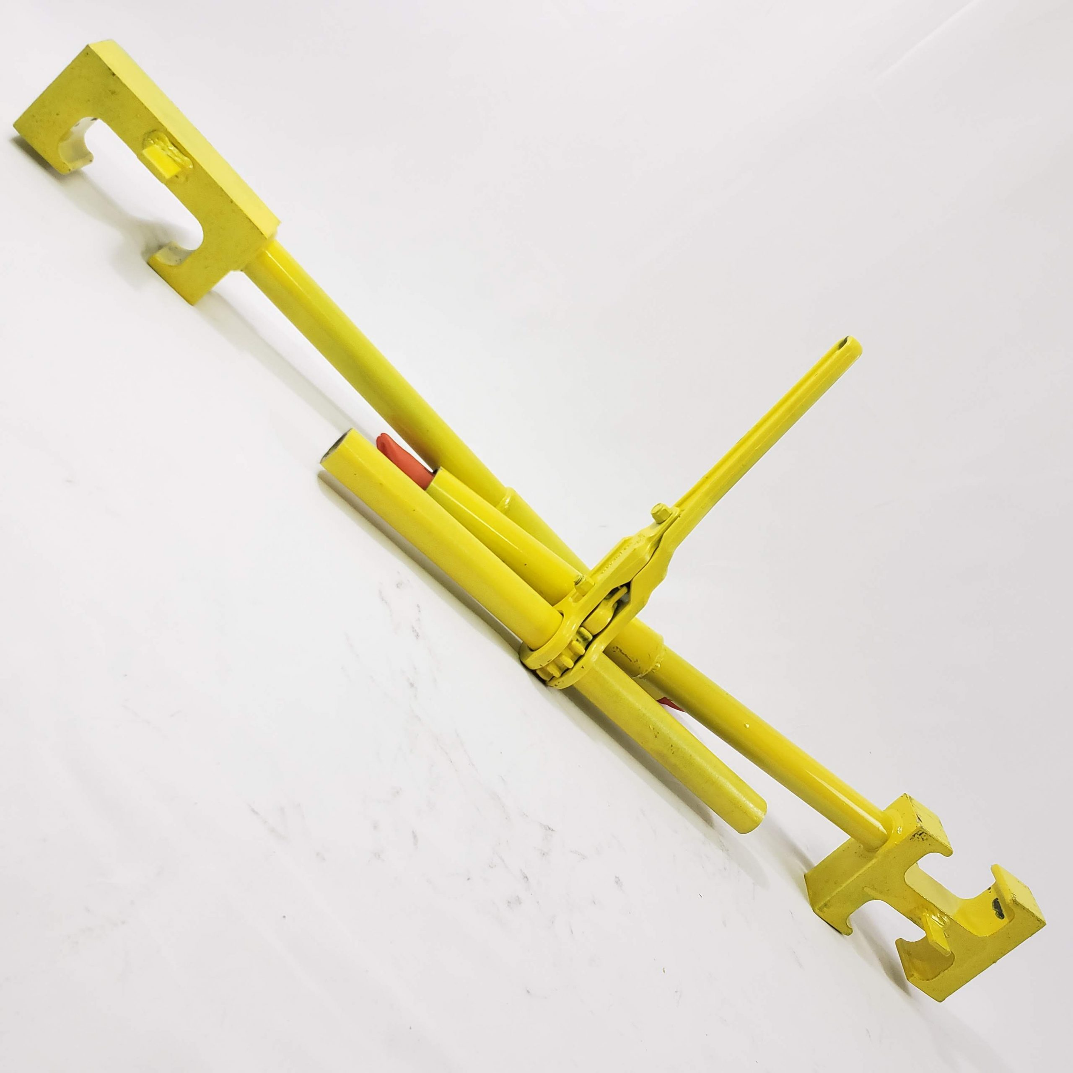
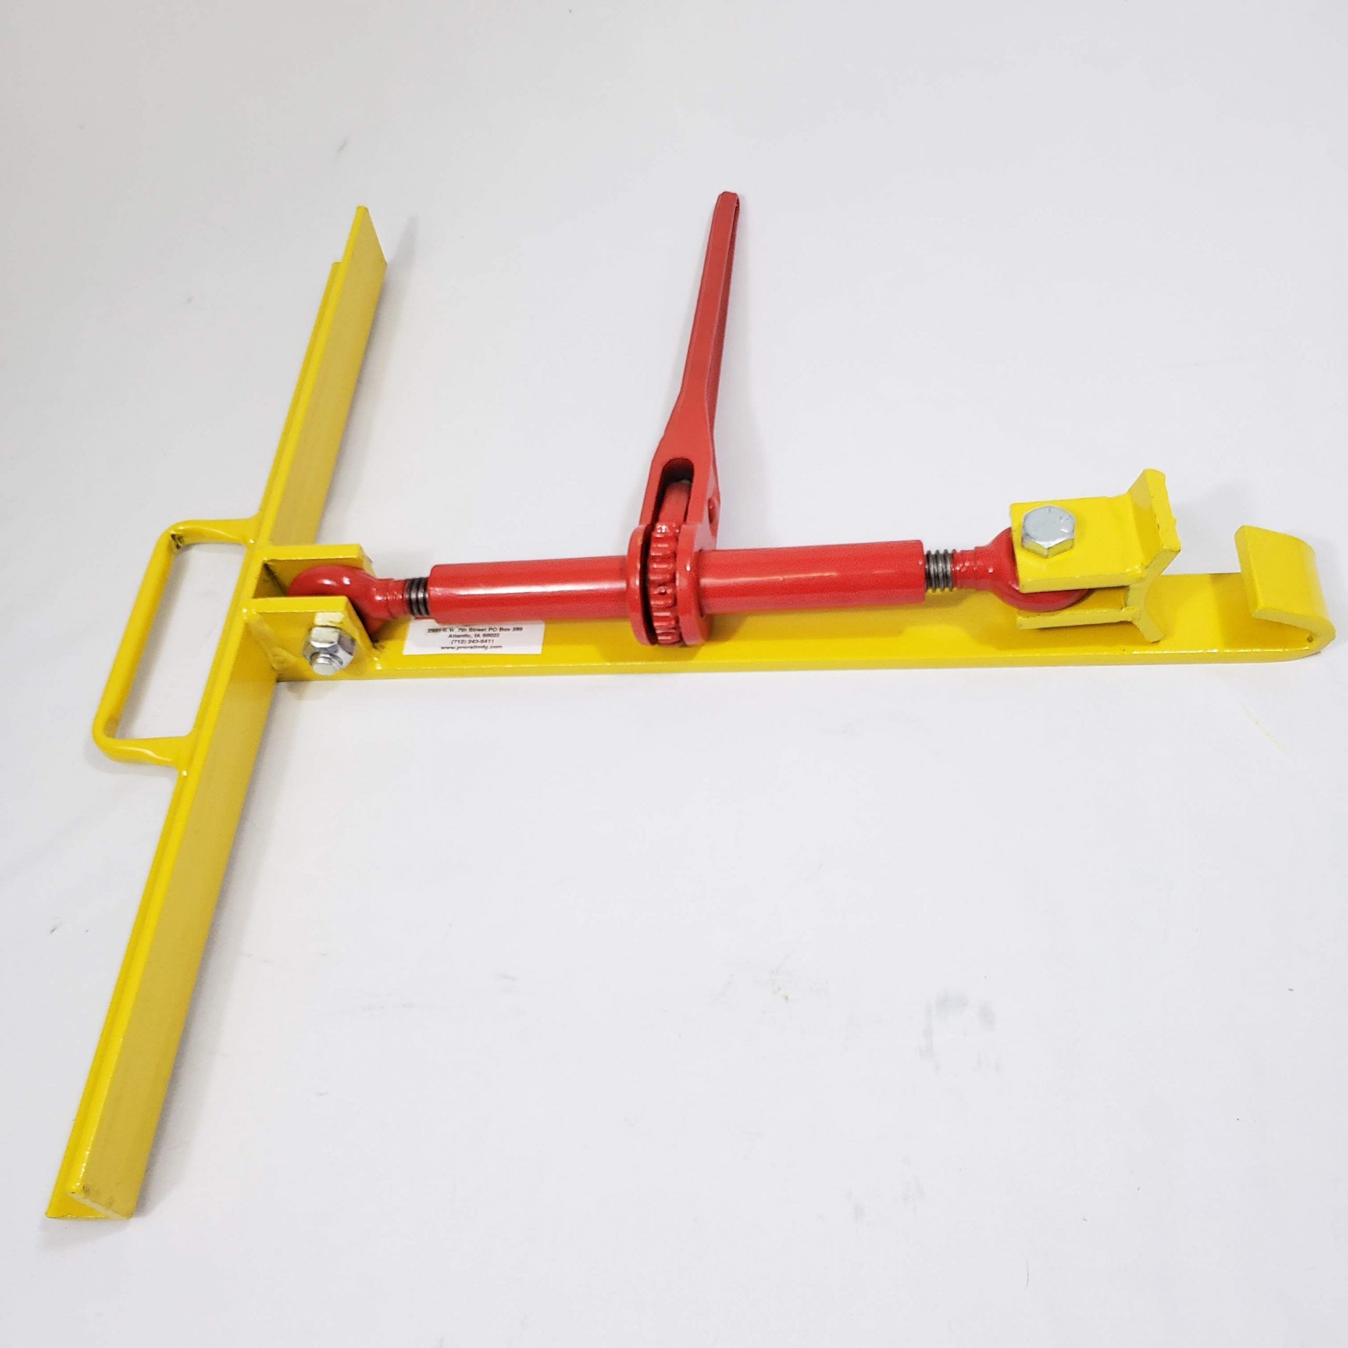

Preliminary Description of Any Technology
Hardware and Software:
Tracks, stations, and infrastructure are designed using computer-aided design (CAD) software.
Project management software (MS Project) is used for scheduling, resource allocation, and cooperation in the construction process management process.
Track alignment and levelling are precisely ensured using high-precision surveying equipment.
To ensure the safety of operations and to coordinate construction activities, advanced communication technologies are necessary.
Tunnel integrity is checked both during and after construction using specialized tools.
Reference:
Agico Group. Feb 10, 2017. How To Build A Railway Track?
http://www.railway-fasteners.com/news/how-to-build-a-railway-track.html

Slide 16
Summary of References
Hendricks, A. n.d. Simply Stakeholders. The Importance of Stakeholders: Identifying and Prioritizing Stakeholder Engagement.
https://simplystakeholders.com/the-importance-of-stakeholders/
Staff, C. November 29, 2023. Cousera. What Is A Project Manager? A Career Guide.
https://www.coursera.org/articles/what-is-project-manager
Wikipedia. n.d. Railway Track
https://en.wikipedia.org/wiki/Railway_track/
Camilleri, C. Mar. 2, 2023. Canadian Train Vacations. Canadian Pacific Railways Facts
https://canadiantrainvacations.com/blog/canadian-pacific-railway-facts#
Government of Canada. n.d. Rail Safety Improvement Program
https://tc.canada.ca/en/programs/funding-programs/rail-safety-improvement-program
Jain, S. Aug. 12, 2023. Medium. “Forging the Path: The Construction of Bullet Train Tracks”
https://medium.com/@samarthjain/forging-the-path-the-construction-of-bullet-train-tracks-d2099a0cd11c
Agico Group. Feb 10, 2017. How To Build A Railway Track?
http://www.railway-fasteners.com/news/how-to-build-a-railway-track.html
Oct. 10, 2023. Federal Railroad Administration. “Positive Train Control (PTC)”
https://railroads.dot.gov/research-development/program-areas/train-control/ptc/positive-train-control-ptc
High-speed rail. (n.d.). Retrieved from Ontario.ca
https://www.ontario.ca/page/high-speed-rail

